Slide 1
Waveforms

Slide 2
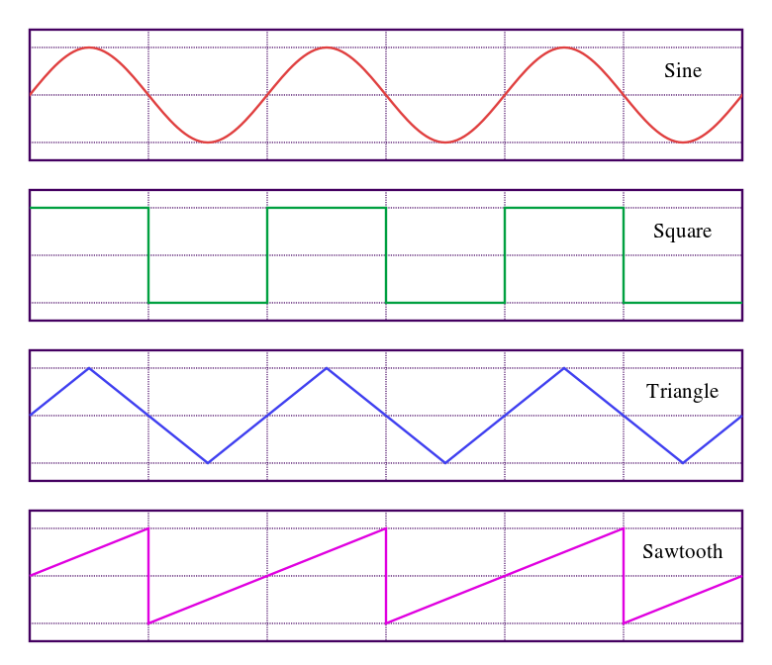
What is a Waveform?
A curve showing the shape of a wave at a given time. - Google
A Waveform is the shape and form of a signal such as a wave moving in a physical medium or an abstract representation. – Wikipedia

Slide 3
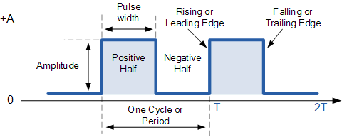
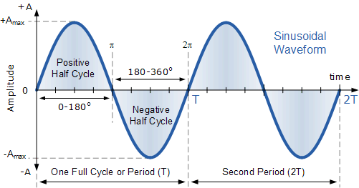
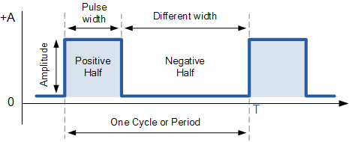
How to Identify?
Dimensions
Mathematical Variables

Slide 4
How to Measure?
Period - This is the length of time in seconds that the waveform takes to repeat itself from start to finish
Frequency - This is the number of times the waveform repeats itself within a one second time period.
Amplitude - This is the magnitude or intensity of the signal waveform measured in volts or amps.

Slide 5
Can we Identify waveforms using Data?
Absolutely!
Data can be a recorded version of Waveforms and its measures.

Slide 6
Waveform Data
Objective:
Predict
Classify
Measures

Slide 7
About the Data
Data Dimensions: 5000x41
Target Variable: Factor: Levels – 0,1,2
Predictors: 40 – Numerical – Continuous
Multiclass Classification

Slide 8
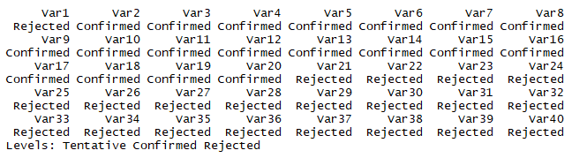
Data Pre-processing
PCA
Boruta
LASSO and RIDGE
Scaling – z-score

Slide 9
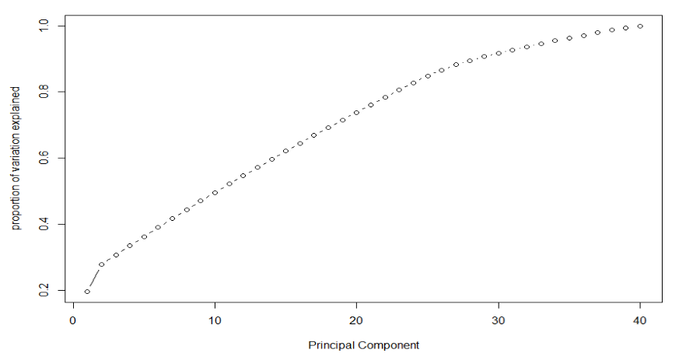
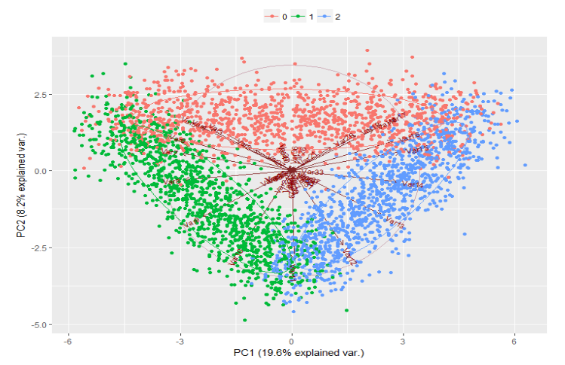
PCA

Slide 10
Boruta
This Algorithm creates Shadow attributes for each attribute in the dataset
Shuffling of attributes to remove correlation and biasness.
Z score noted by executing Random Forest.
At every iteration, calculates Maximum Z Score among each Shadow attributes (MZSA) and checks whether a real feature has a higher importance than the MZSA or lower.
Mark the attributes which have importance significantly lower than MZSA as ‘unimportant’ and permanently remove them from the information system.
Mark the attributes which have importance significantly higher than MZSA as ‘important’.
Repeat the procedure until all the features are marked, or the algorithm has reached the previously set limit of the random forest runs.
At the end, remove all shadow attributes.

Slide 11
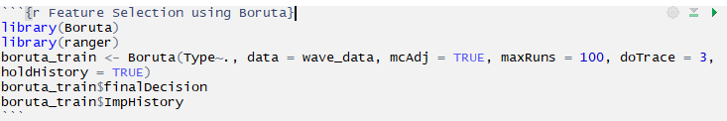
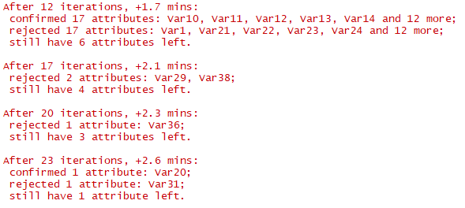
Boruta

Slide 12
Models Implemented
K-NN
SVM
Random Forest
GBM
Logistic Regression
LASSO – RIDGE
Naïve Bayes
XG Boost
ANN

Slide 13
Metrics Achieved

Slide 14
Improvements
Stacking
Ensembles

